Slide 1


Student Details. Duration: 6weeks Internship start date: 03 june 2024 Internship. End date:15 july 2024
Name:Dokku Karthik
Rollno:22X41A0416
E-mail id: dokkukarthik2@gmail.com
Branch:ECE
Domain name: AIML
College:SRK Institute of TechnologyAIR Port Road, 3-44, Eluru Rd, Enikepadu, Vijayawada, Andhra Pradesh 521108

Slide 2
Problem Statement: Employee Burnout Prediction
Employee burnout is a significant concern in modern workplaces, impacting productivity, employee satisfaction, and overall organizational health. Burnout can lead to decreased performance, higher turnover rates, and increased absenteeism. Identifying and mitigating burnout early can help organizations support their employees more effectively and maintain a healthy work environment.

Slide 3
AGENDA
Prioritizing the project will involve defining its objectives, deliverables, and success criteria, assembling a capable team, and setting its boundaries. Making a thorough timetable with important checkpoints comes next. First, we will compile the dataset and perform exploratory data analysis, or EDA, to understand its structure and contents and identify trends and anomalies. During the data preprocessing phase, we will deal with missing values, outliers, and inconsistencies; scale numerical features; alter categorical variables; and engineer new features. Selecting suitable machine learning algorithms for regression applications, such as XGBoost, decision trees, random forests, and linear regression, comes next after splitting the data into training and testing sets for model training.The effectiveness of the model will be evaluated using metrics such as RMSE, MAE, and R2 score. The model's performance will then be maximized by hyperparameter adjustment. Finally, we will examine the model's results to shine light on the main reasons of employee burnout and offer the business useful recommendations for lowering it.

Slide 4
PROJECT OVERVIEW
Predictive Modeling:-Develop and train machine learning models to predict the burnout rate for each employee.
Data Insights:- Analyze the data to uncover key factors contributing to employee burnout.
Actionable Recommendations:-Provide insights and recommendations for organizations to mitigate employee burnout effectively.
Dataset contains:
Employee ID, Date of Joining, Gender, Company Type,WFH Setup Available, Designation, Resource Allocation,Mental Fatigue Score, Burn Rate
Data Understanding and Exploration
Data Preprocessing
Model Development
Model Evaluation and Insights

Slide 5
THE END USERS of this project.
Organisation
Owners
Human Resources (HR) Teams
Management and Leadership
Occupational Health and Safety (OHS) Officers
Employee Assistance Programs (EAP) Providers
Data Analysts and Researchers
Employees

Slide 6
SOLUTION AND ITS VALUE PROPOSITION
The method comprises developing a comprehensive predictive model that assesses burnout among employees by taking into account a number of factors, such as job characteristics, markers of mental health, and demographics. This model will use state-of-the-art machine learning techniques to analyze the dataset and identify significant burnout predictors.
Proactive Burnout Management.
Enhanced Employee Well-being.
Organizational Benefits.
Data-Driven Decision Making.

Slide 7
customization of burn out employee
Deep Understanding of Context
Advanced Data Processing Techniques
Model Selection and Customization
Incorporating Psychological Factors
Continuous Improvement Framework

Slide 8
MODELLING
Preparing Data
Data splitting: Divide the dataset into sets for testing and training.
Standardize numerical characteristics by feature scaling.
Transform categorical variables into a numerical format by encoding them.
2. Training Models
Determine the Linear Regression Fit Model: Utilizing the training dataset, train the linear regression model.
3. Assessment of the Model
Performance Metrics: Use measures like RMSE, MAE, and R2 score to assess the model's performance.
4. Model Adjustment
Feature Selection: To enhance model performance, evaluate and pick the most important features.

Slide 9
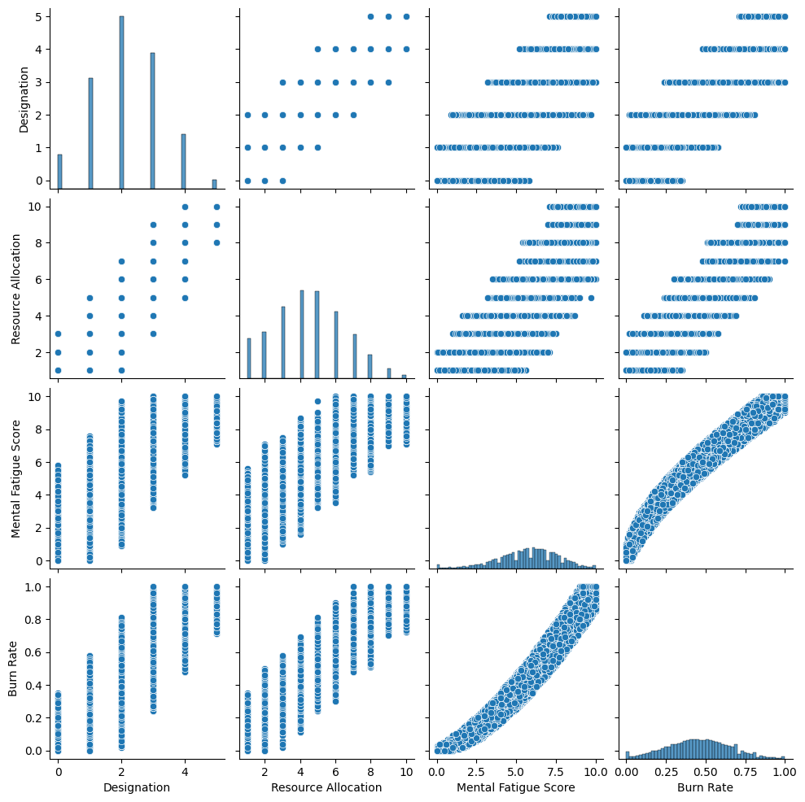
Results

Slide 10
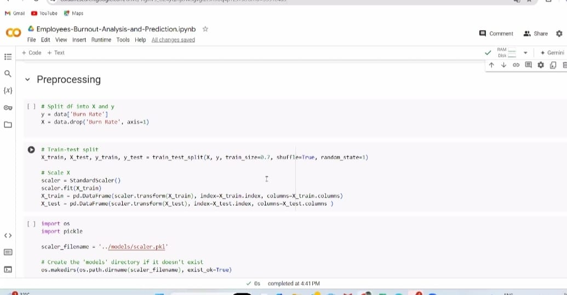

Slide 11
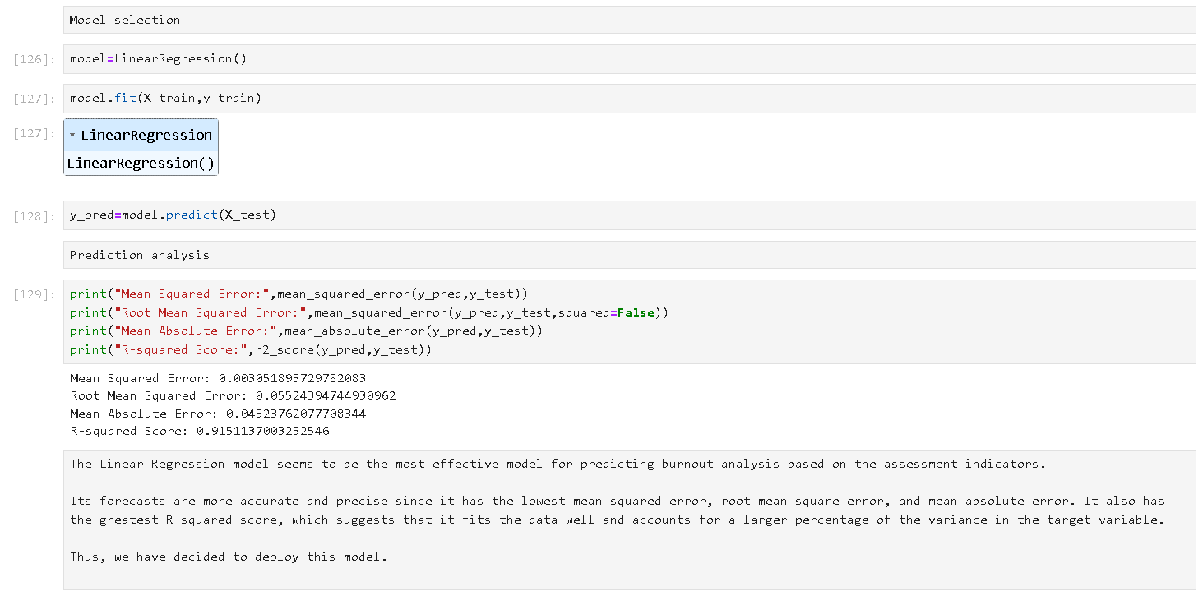

Slide 12
links
DATASET LINK :https://www.kaggle.com/datasets/blurredmachine/are-your-employees-burning-out
MAIL : dokkukarthik2@gmail.com

